Slide 1
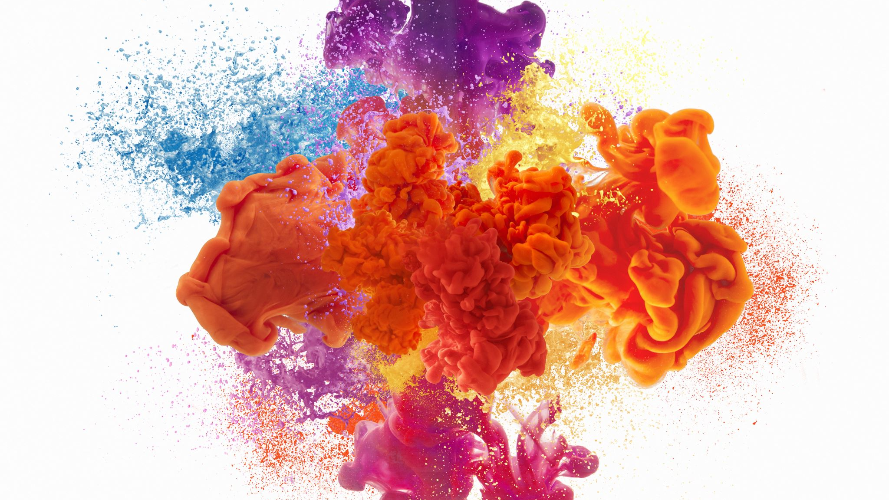
Physical Changes

Slide 2
Before you start…
* Make sure that an adult is with you when you attempt this experiment
* Each step must be carefully read and followed
* Answer the questions
* Have fun!!!

Slide 3
Physical Change Experiment
Running pepper

Slide 4
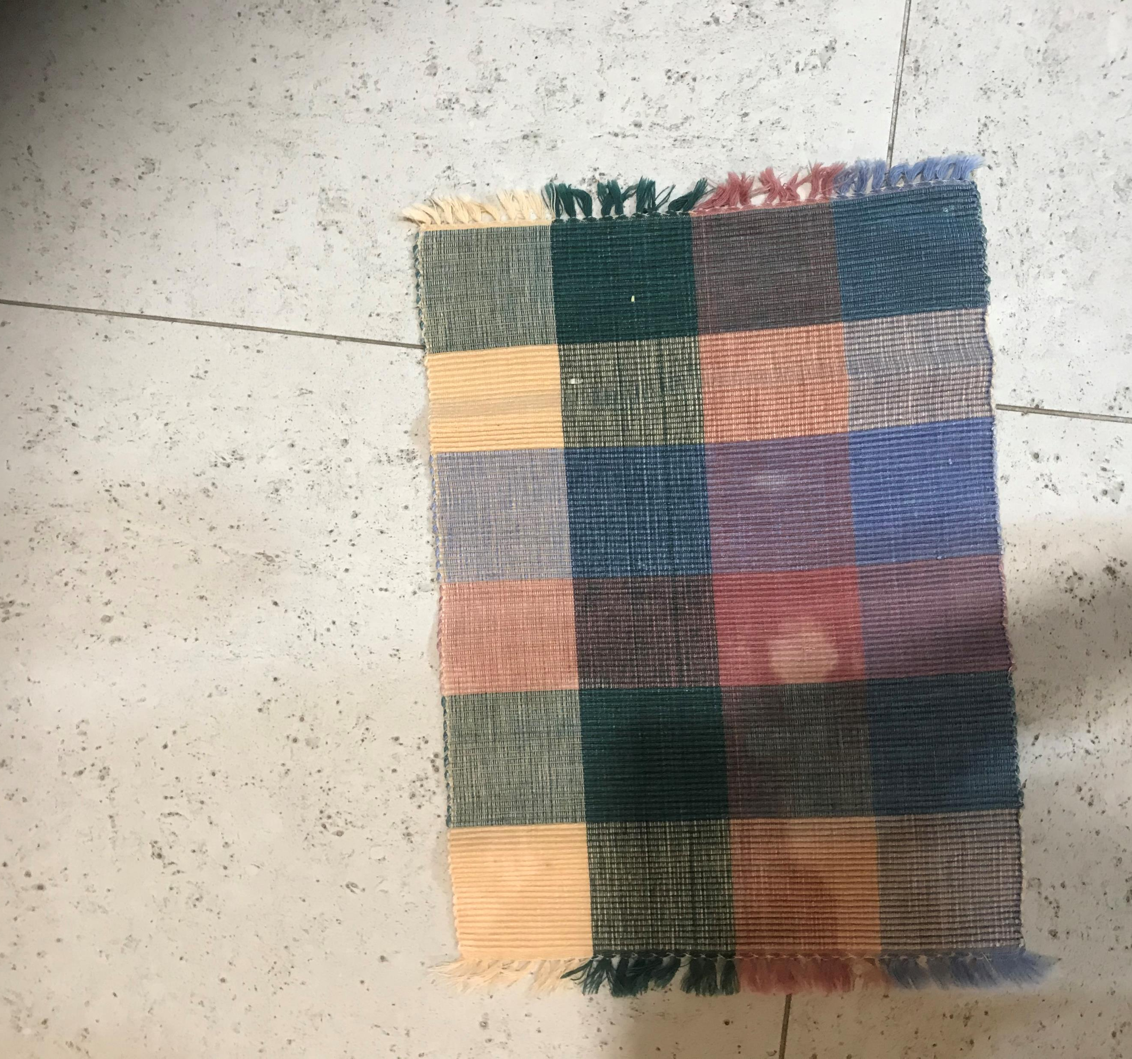
The first step is to lay out an old towel in a clear space.

Slide 5
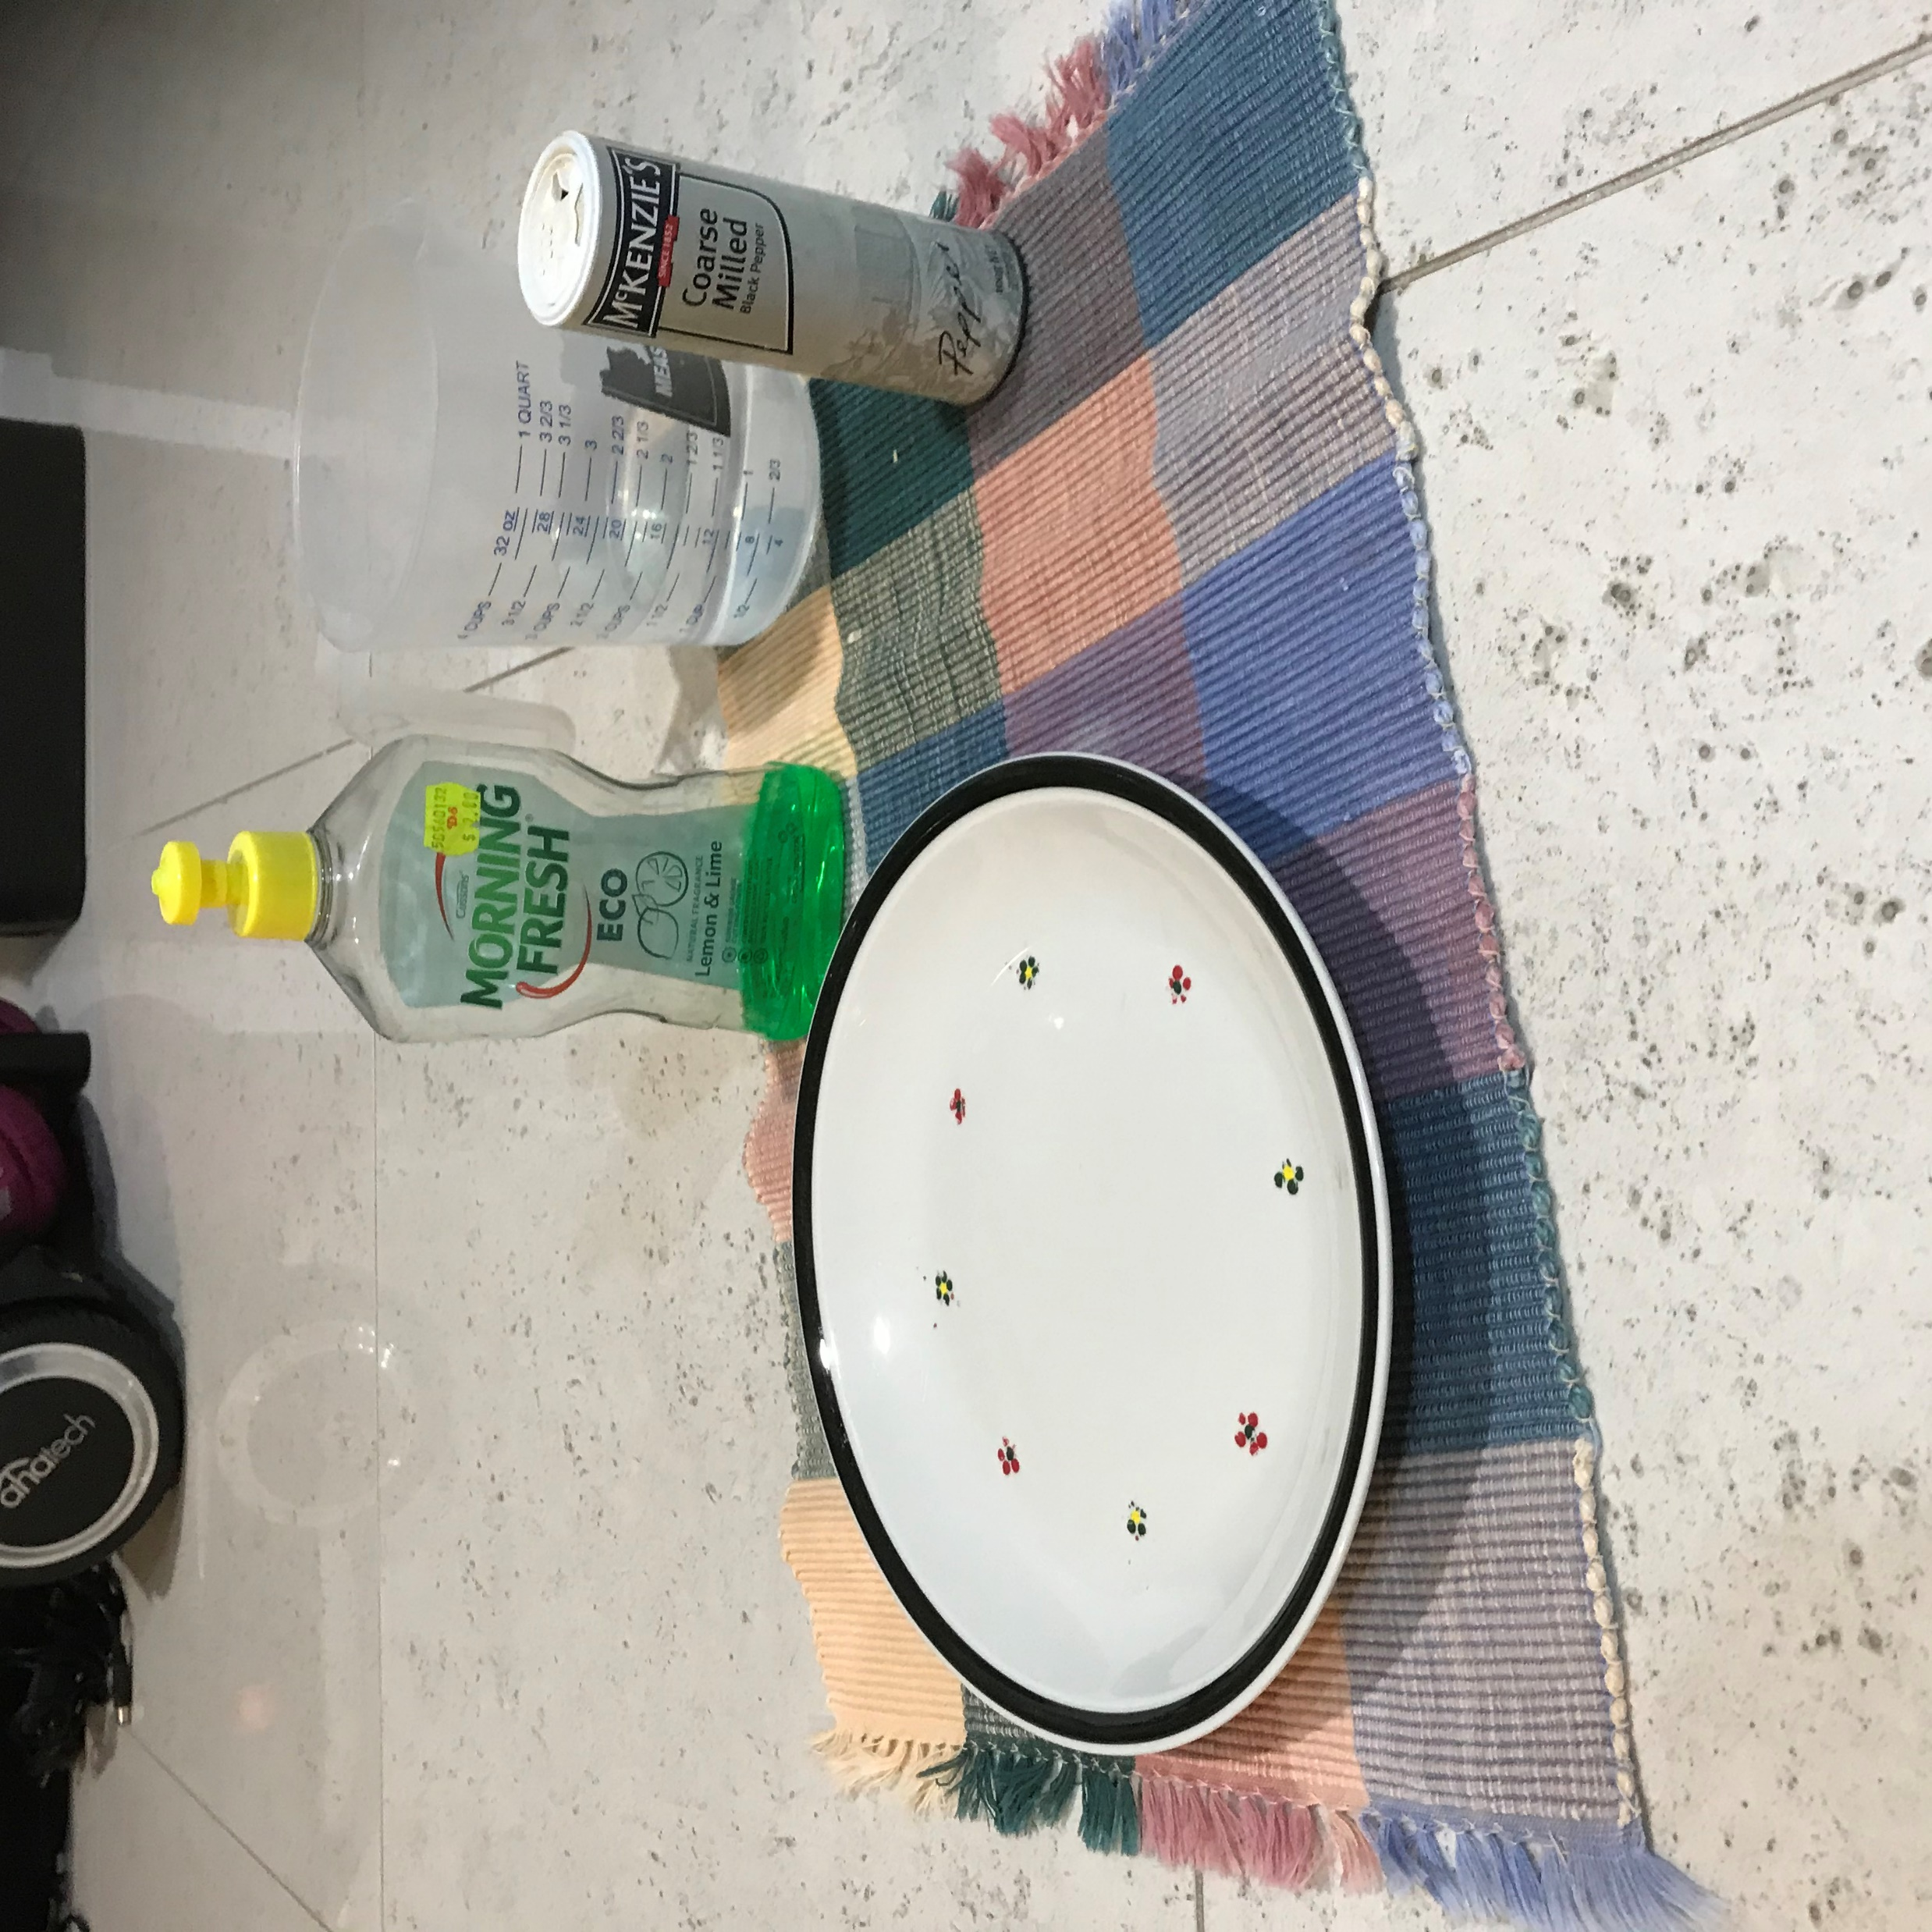
Next, is to get out all your ingredients and equipment and put them on the towel.
These include: a large plate, dish washing liquid, a jug of water and some pepper.

Slide 6
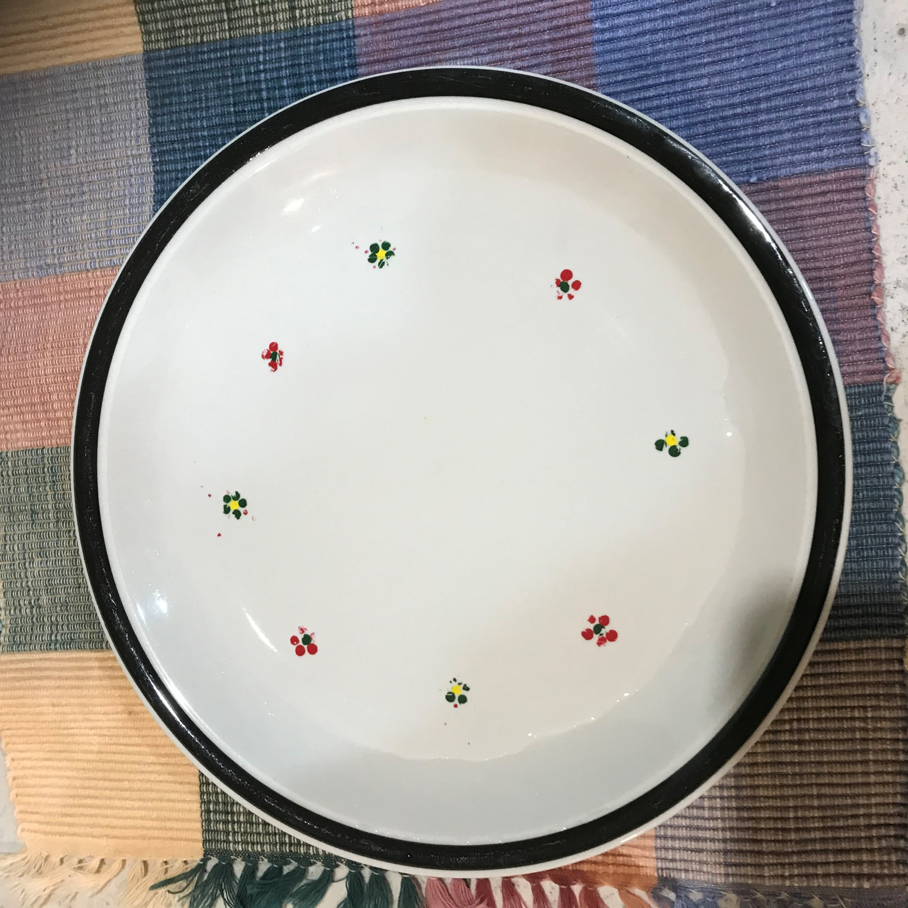
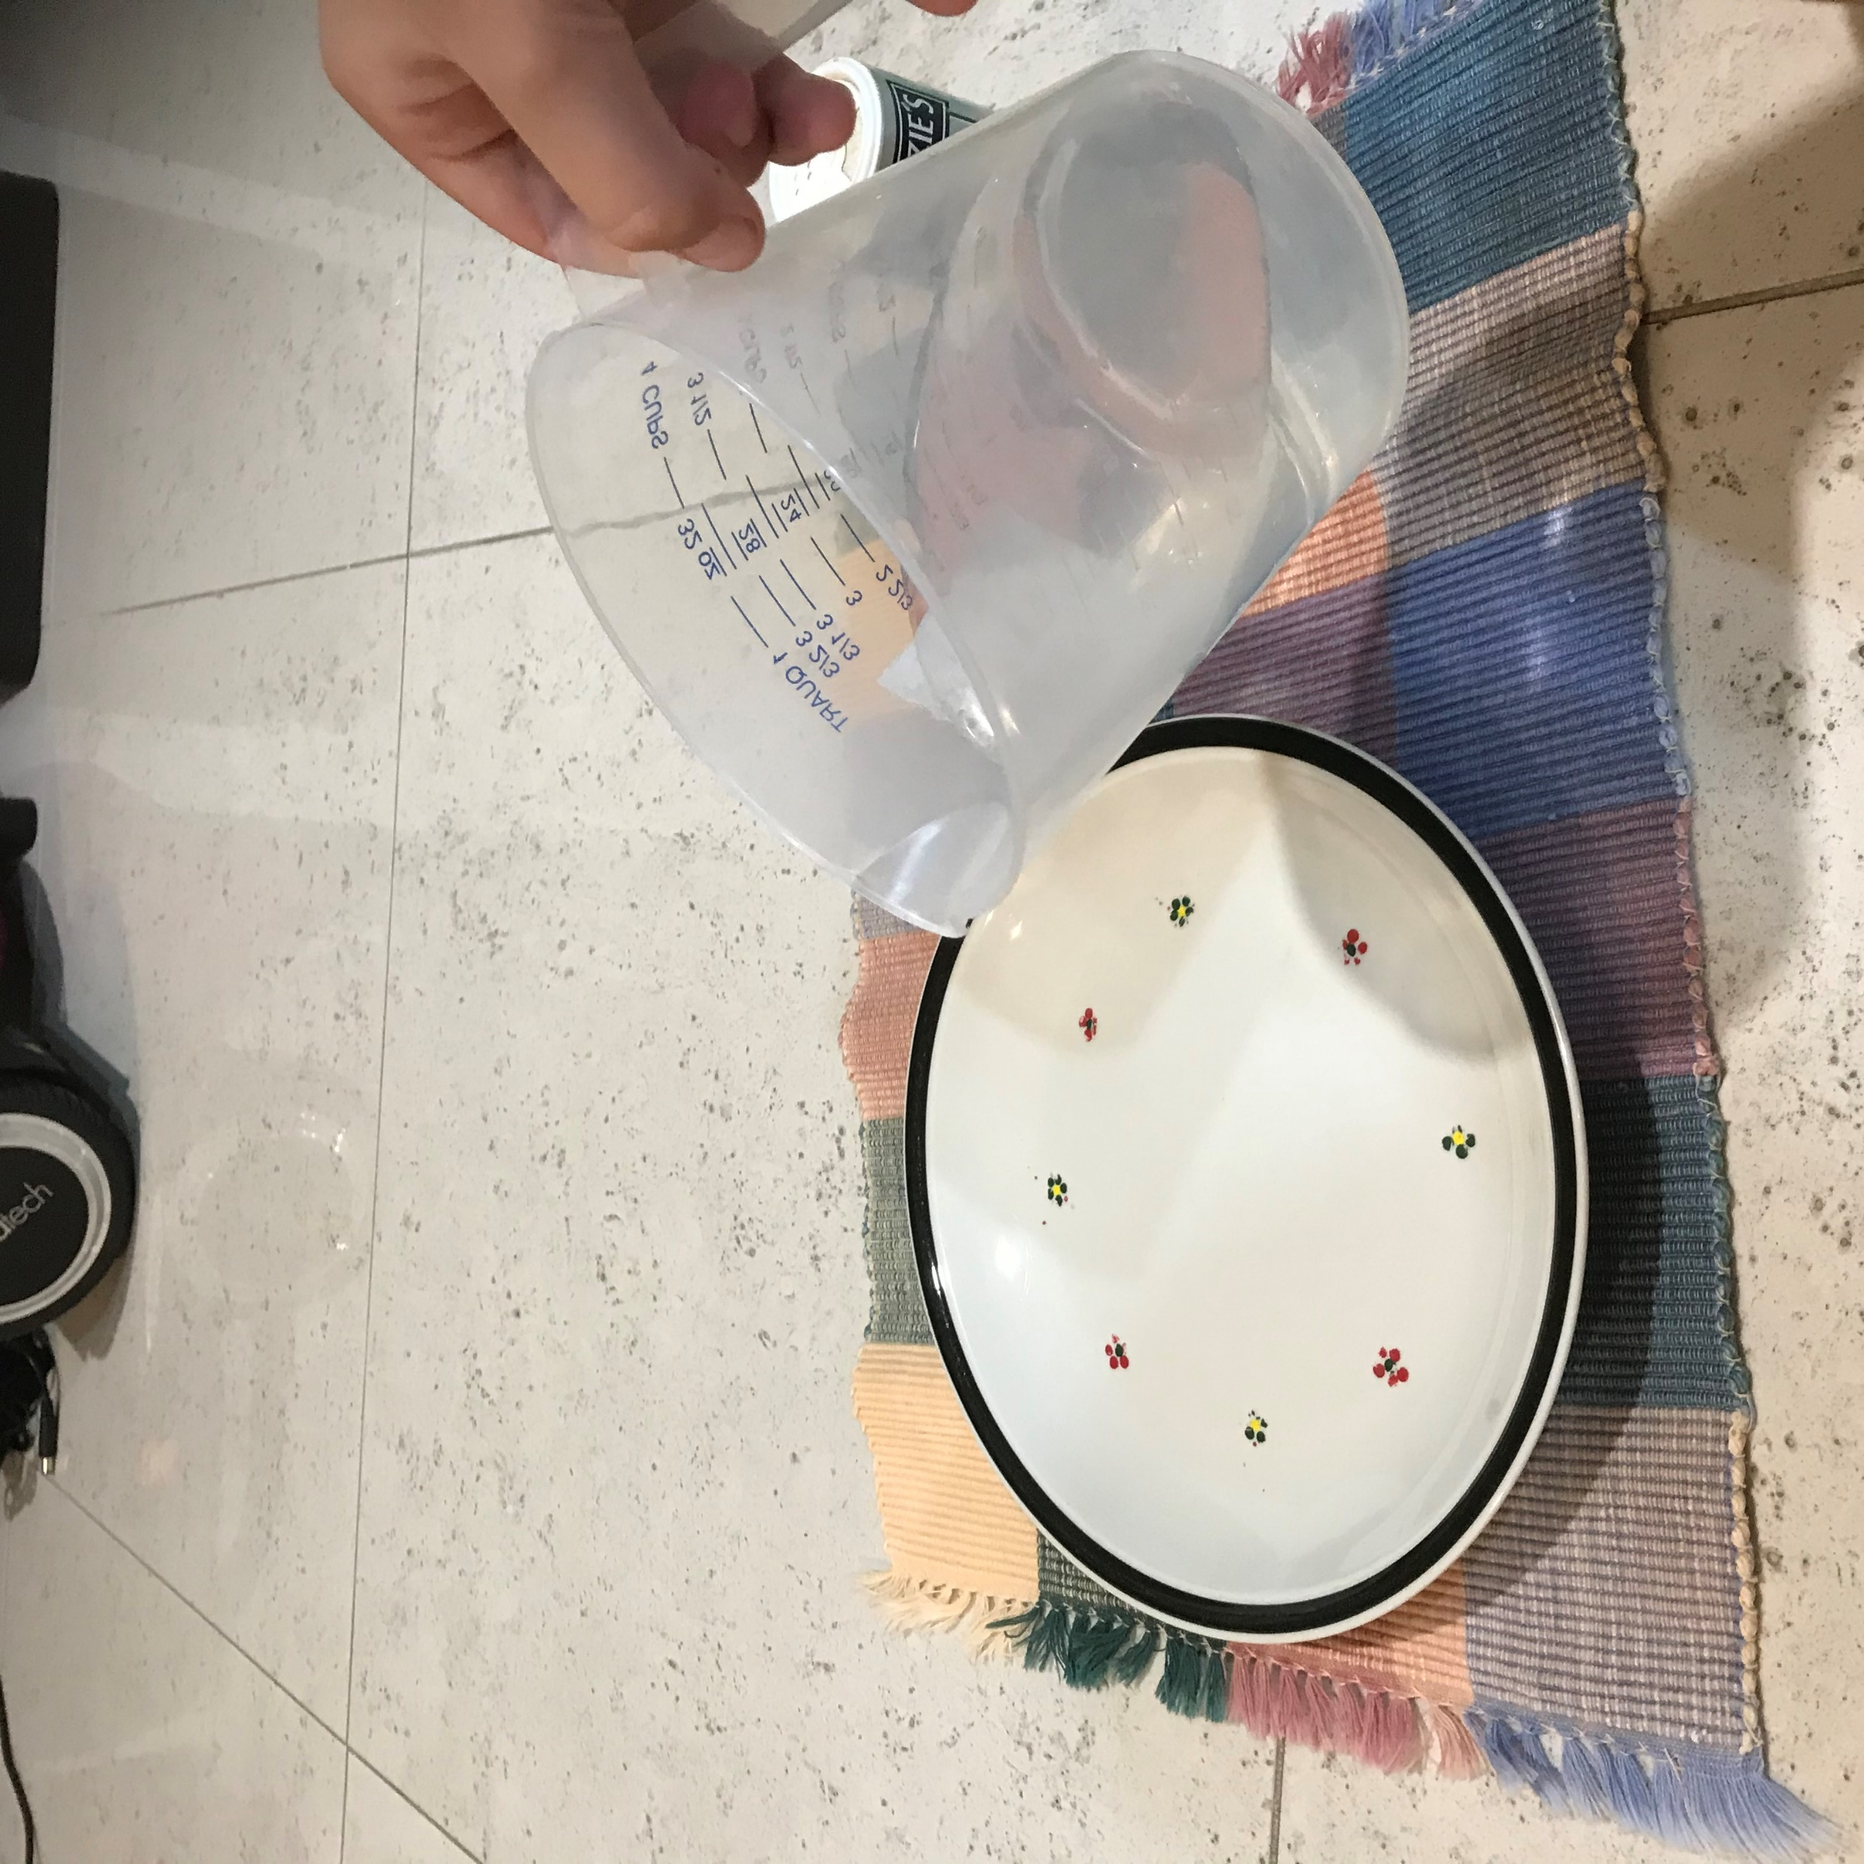
After all the ingredients are out, pour some water onto the plate, make sure it doesn’t overflow.

Slide 7
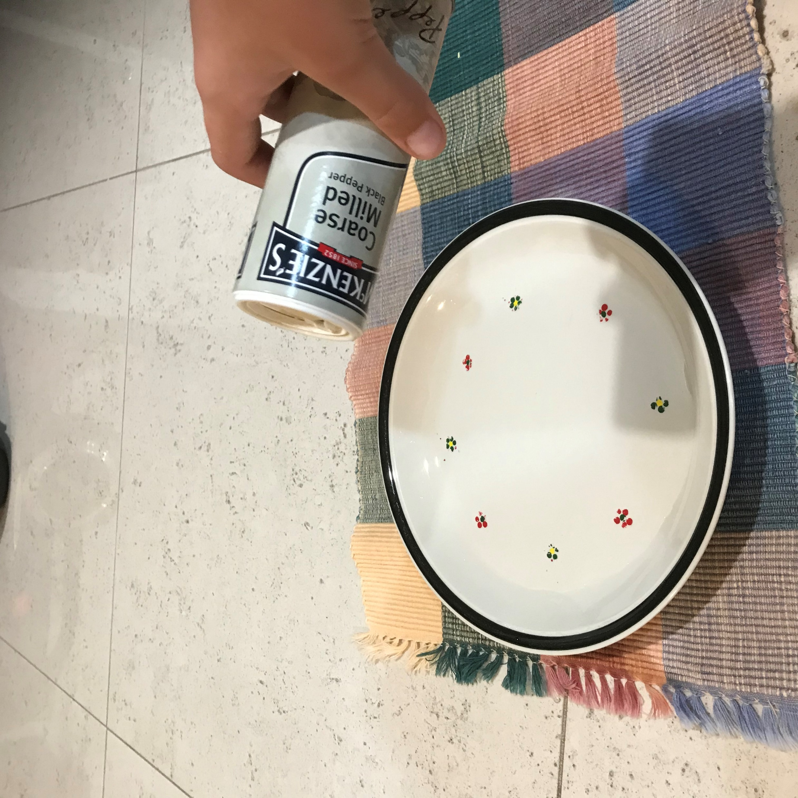
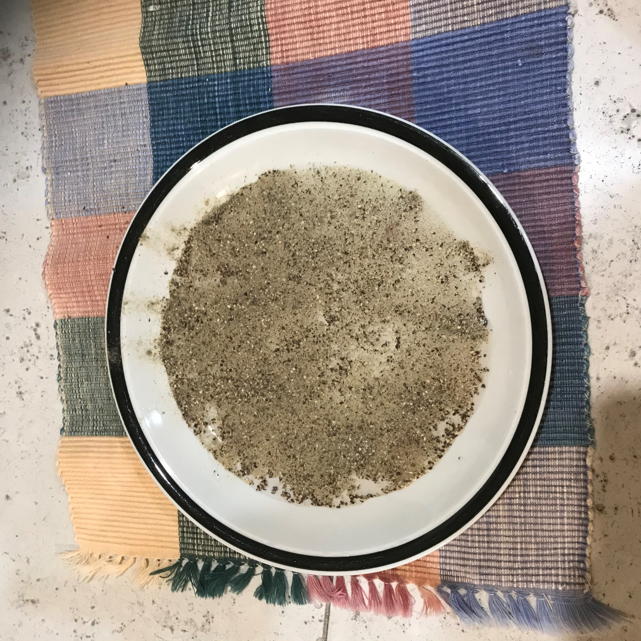
After the water is poured in, shake some pepper on top of the water until the surface is fully covered.

Slide 8
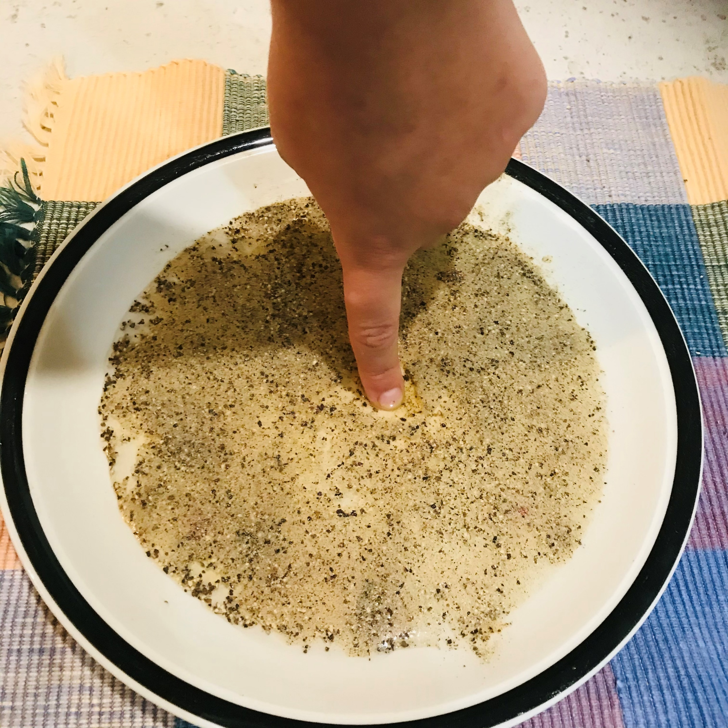
Poke your finger in the pepper.
How does it feel?
What happens to the pepper?
Where is your finger?

Slide 9
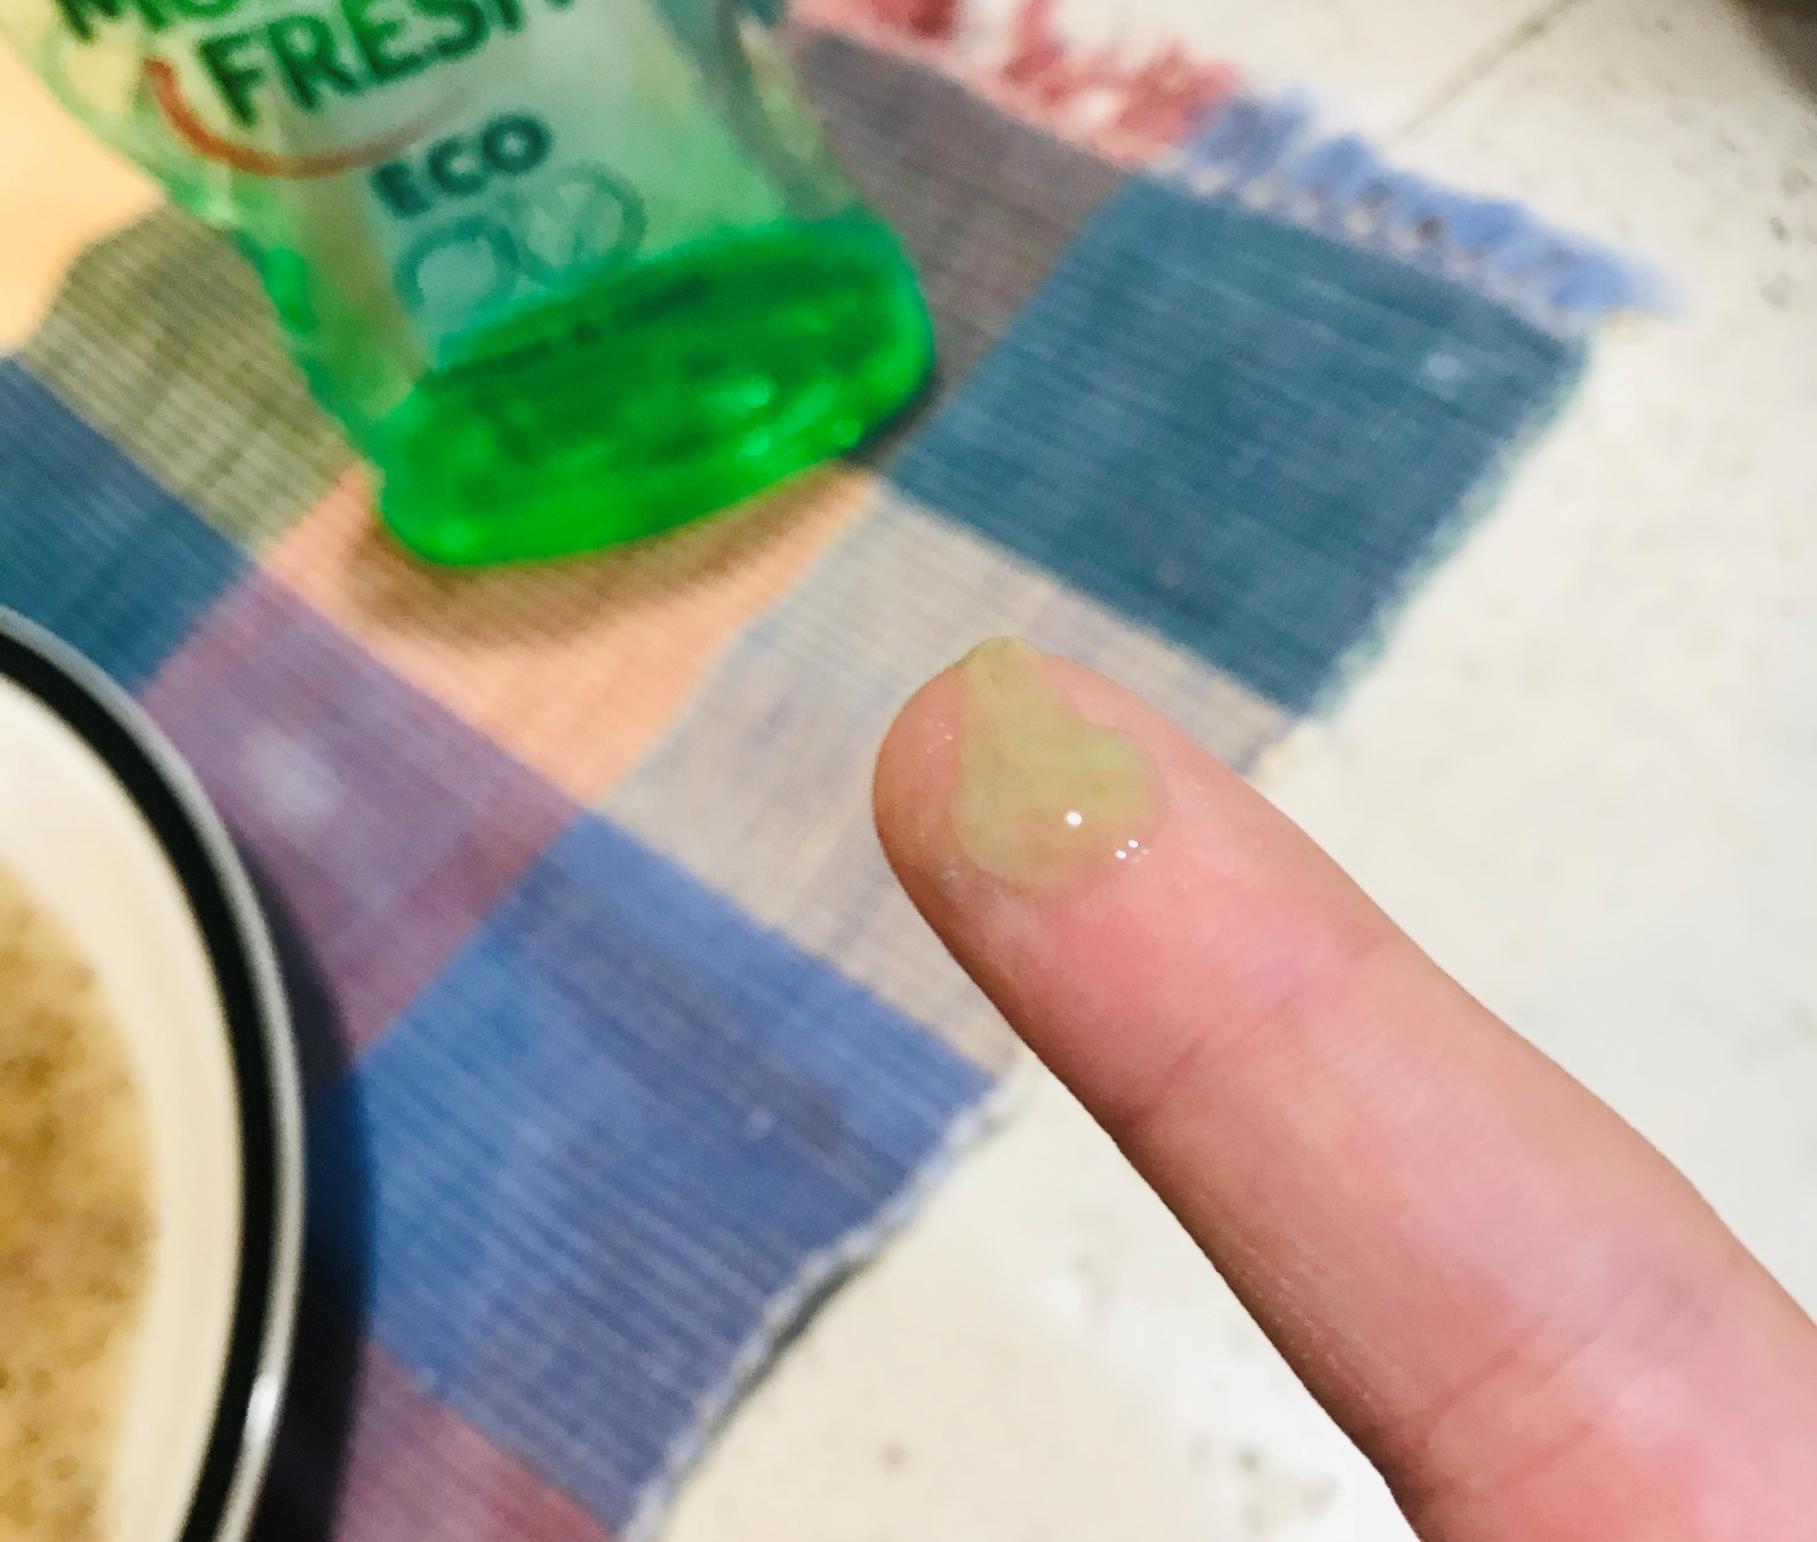
Now put a tiny blob of dish washing liquid on your finger.

Slide 10
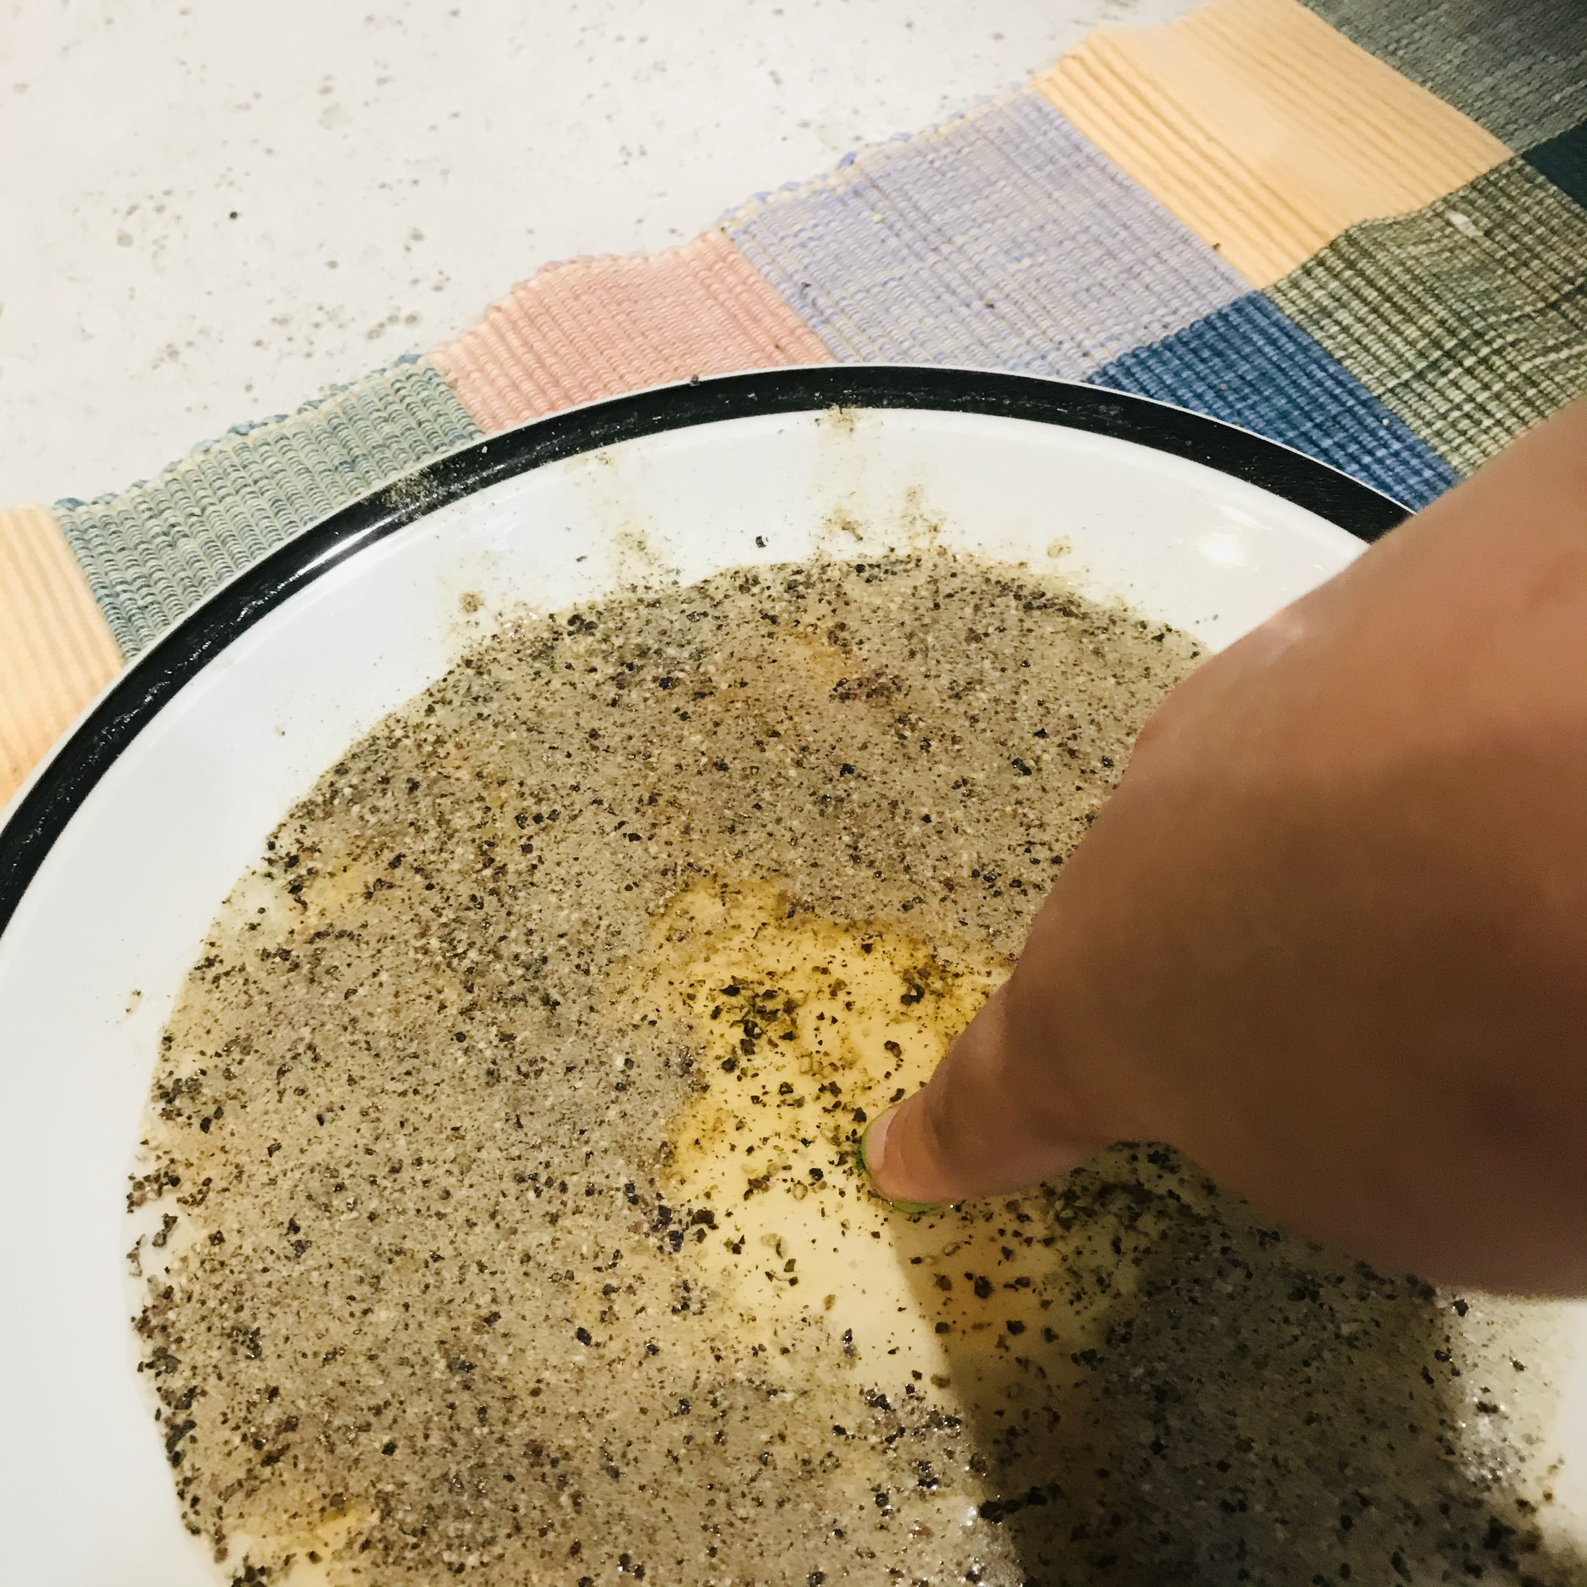
Poke that finger in the pepper and water.
What happens?
Is this different from before?
Why do you think this happened?
Could this work using salt? Why/why not?
Could this work using your big toe? Why/why not?
Write down 3 things that you have learnt about this experiment

